Slide 1

Mobile Application Development
Welcome
Class: BS(CS)-VII
Sukkur IBA University – Kandhkot Campus
Week - 02
Lecture – 03 & 04
Your Facilitator, Adil Khan

Slide 2
Activity

Slide 3
Activity
An activity represents a single screen in your app with an interface the user can interact with.
For example, an email app might have one activity that shows a list of new emails, another activity to compose an email, and another activity for reading individual messages.
Your app is probably a collection of activities that you create yourself, or that you reuse from other apps.
Although the activities in your app work with each other to form a cohesive user experience, each activity is independent of the others.
This enables your app to start an activity in another app, and it enables other apps to start activities in your app (if your app allows this).
For example, a messaging app could start an activity in a camera app to take a picture, then start an activity in an email app to let the user share the picture in email.

Slide 4
Activity

Slide 5
Activity
Typically, one Activity in an app is specified as the "main" activity, for example MainActivity.
The user sees the main activity when they launch the app for the first time.
Each activity can start other activities to perform different actions.
Each time a new activity starts, the previous activity is stopped, but the system preserves the activity in a stack (the "back stack").
When the user is done with the current activity and presses the Back button, the activity is popped from the stack and destroyed, and the previous activity resumes.
When an activity is stopped because a new activity starts, the first activity is notified by way of the activity lifecycle callback methods.
The activity lifecycle is the set of states an Activity can be in: when the activity is first created, when it's stopped or resumed, and when the system destroys it.

Slide 6
Creating an Activity
To implement an Activity in your app, do the following:
Create an Activity Java class.
Implement a basic UI for the Activity in an XML layout file.
Declare the new Activity in the AndroidManifest.xml file.

Slide 7
Creating an Activity
When you create a new project in Android Studio and choose the Backwards Compatibility (AppCompat) option, the MainActivity is, by default, a subclass of the AppCompatActivity class.
The AppCompatActivity class lets you use up-to-date Android app features such as the app bar and Material Design, while still enabling your app to be compatible with devices running older versions of Android.
Here is a skeleton subclass of AppCompatActivity:
public class MainActivity extends AppCompatActivity {
@Override
protected void onCreate(Bundle savedInstanceState) {
super.onCreate(savedInstanceState);
setContentView(R.layout.activity_main);
}
}

Slide 8
Activity Life Cycle

Slide 9
Activity Lifecycle
The activity lifecycle is the set of states an activity can be in during its entire lifetime, from the time it is initially created to when it is destroyed, and the system reclaims that activity’s resources.
As the user interacts with your app and other apps on the device, the different activities move into different states.
For example, when you start an app, the app's main activity (Activity 1) is started, comes to the foreground, and receives the user focus.

Slide 10
Activity Lifecycle
When you start a second activity (Activity 2), that new activity is also created and started, and the main activity is stopped.
When you're done with the second activity and navigate back, the first activity resumes.
The second activity stops and is no longer needed; if the user does not resume the second activity, it is eventually destroyed by the system.

Slide 11
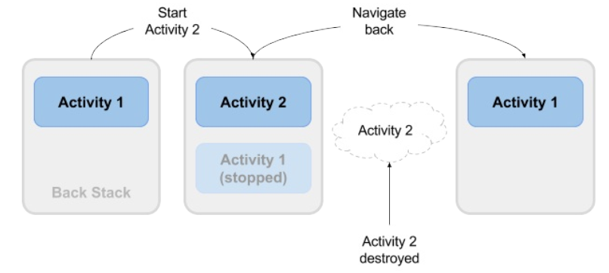
Activity Lifecycle

Slide 12
Activity Lifecycle
Every instance of Activity has a lifecycle. During this lifecycle, an activity transitions between different states: created, started, resumed, paused, stopped, and nonexistent/dead.
For each transition, there is an Activity method that notifies the activity of the change in its state.

Slide 13
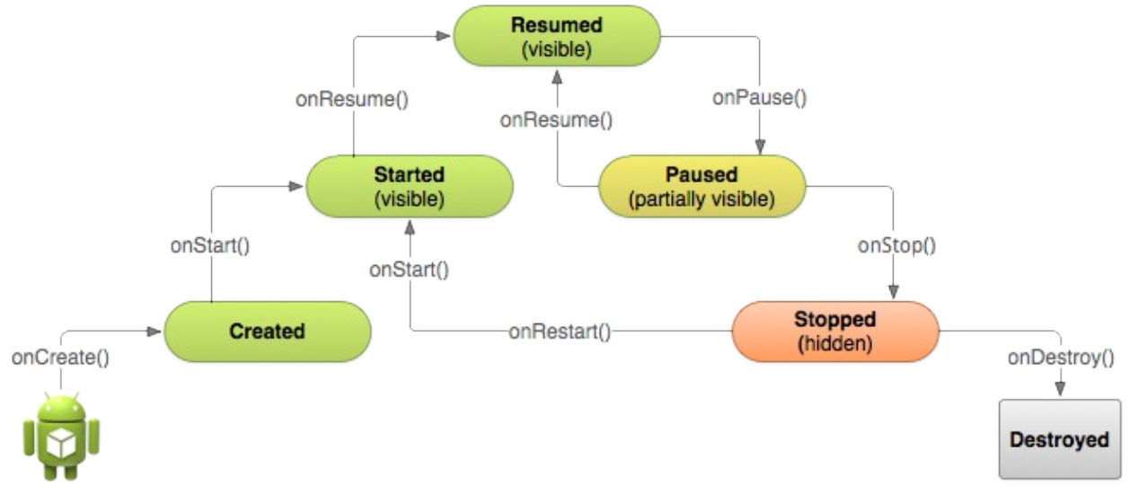
Activity Lifecycle

Slide 14
Activity Lifecycle – onCreate()
Your activity enters into the created state when it is started for the first time. When an activity is first created the system calls the onCreate() method to initialize that activity.
Similarly, if your app starts another activity with an intent (either explicit or implicit), the system matches your intent request with an activity and calls onCreate() for that new activity.
The onCreate() method is the only required callback you must implement in your activity class. In your onCreate() method you perform basic application startup logic that should happen only once, such as setting up the user interface, assigning class-scope variables, or setting up background tasks.

Slide 15
Activity Lifecycle – onStart()
After your activity is initialized with onCreate(), the system calls the onStart() method, and the activity is in the started state.
The onStart() method is also called if a stopped activity returns to the foreground, such as when the user clicks the back or up buttons to navigate to the previous screen.
While onCreate() is called only once when the activity is created, the onStart() method may be called many times during the lifecycle of the activity as the user navigates around your app.

Slide 16
Activity Lifecycle – onStart()
When an activity is in the started state and visible on the screen, the user cannot interact with it until onResume() is called, the activity is running, and the activity is in the foreground.
Typically you implement onStart() in your activity as a counterpart to the onStop() method. For example, if you release hardware resources (such as GPS or sensors) when the activity is stopped, you can re-register those resources in the onStart() method.

Slide 17
Activity Lifecycle – onResume()
Your activity is in the resumed state when it is initialized, visible on screen, and ready to use.
The resumed state is often called the running state, because it is in this state that the user is actually interacting with your app.
The first time the activity is started the system calls the onResume() method just after onStart(). The onResume() method may also be called multiple times, each time the app comes back from the paused state.

Slide 18
Activity Lifecycle – onResume()
You typically only implement onResume() as a counterpart to onPause(). For example, if in the onPause() method you halt any onscreen animations, you would start those animations again in onResume().
The activity remains in the resumed state as long as the activity is in the foreground and the user is interacting with it. From the resumed state the activity can move into the paused state.

Slide 19
Activity Lifecycle – onPause()
The paused state can occur in several situations:
The activity is going into the background, but has not yet been fully stopped. This is the first indication that the user is leaving your activity.
The activity is only partially visible on the screen, because a dialog or other transparent activity is overlaid on top of it. Like getting a phone call etc.
The system calls the onPause() method when the activity moves into the paused state. Because the onPause() method is the first indication you get that the user may be leaving the activity, you can use onPause() to stop animation or video playback, release any hardware-intensive resources, or commit unsaved activity changes (such as a draft email).

Slide 20
Activity Lifecycle – onPause()
Your activity can move from the paused state into the resumed state (if the user returns to the activity) or to the stopped state (if the user leaves the activity altogether).

Slide 21
Activity Lifecycle – onStop()
An activity is in the stopped state when it is no longer visible on the screen at all. This is usually because the user has started another activity, or returned to the home screen.
The system retains the activity instance in the back stack, and if the user returns to that activity it is restarted again. Stopped activities may be killed altogether by the Android system if resources are low.
The system calls the onStop() method when the activity stops. Implement the onStop() method to save any persistent data and release any remaining resources you did not already release in onPause().

Slide 22
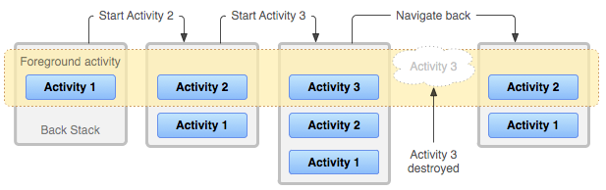
Activity Lifecycle – Back Stack

Slide 23
Activity Lifecycle – onDestroy()
When your activity is destroyed it is shut down completely, and the Activity instance is reclaimed by the system. This can happen in several cases:
You call finish() in your activity to manually shut it down.
The user navigates back to the previous activity.
The device is in a low memory situation where the system reclaims stopped activities to free more resources.
A device configuration change occurs.
Use onDestroy() to fully clean up after your activity so that no component (such as a thread) is running after the activity is destroyed.

Slide 24
Activity Lifecycle – onDestroy()
Note that there are situations where the system will simply kill the activity's hosting process without calling this method (or any others), so you should not rely on onDestroy() to save any required data or activity state. Use onPause() or onStop() instead.

Slide 25
Configuration changes
Configuration changes occur on the device, in runtime, and invalidate the current layout or other resources in your activity
The most common form of a configuration change is when the device is rotated.
When the device rotates from portrait to landscape, or vice versa, the layout for your app also needs to change.
The system recreates the activity to help that activity adapt to the new configuration by loading alternative resources (such as a landscape-specific layout).

Slide 26
Configuration changes
When a configuration change occurs Android system shuts down your activity (calling onPause(), onStop(), and onDestroy()), and then starts it over again from the start (calling onCreate(), onStart(), and onResume()).

Slide 27
Activity Lifecycle – onRestart()
The restarted state is a transient state that only occurs if a stopped activity is started again. In this case the onRestart() method is called in between onStop() and onStart().

Slide 28
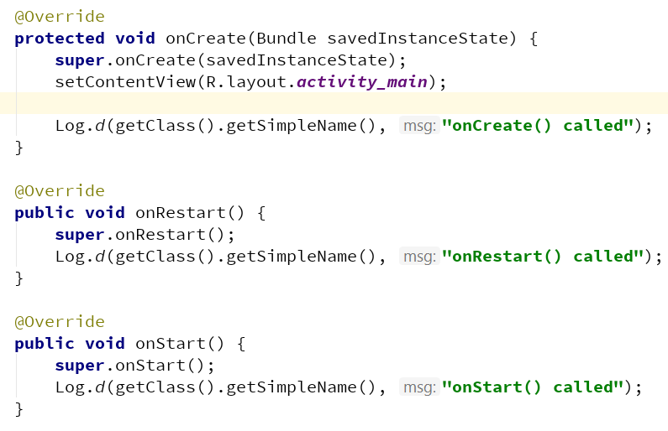
Activity Lifecycle - Example

Slide 29
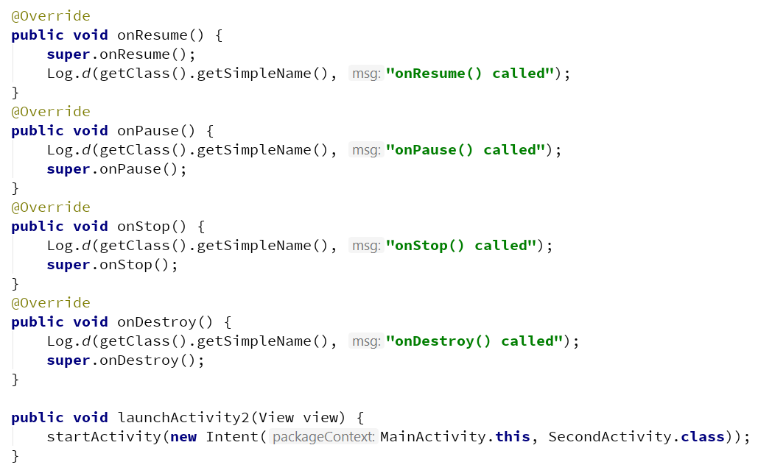
Activity Lifecycle - Example

Slide 30
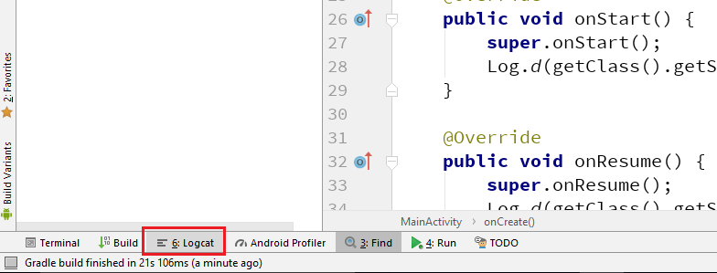
Activity Lifecycle - Example
Same lifecycle methods are overridden in SecondActivity.
Running the code and viewing the Logcat

Slide 31
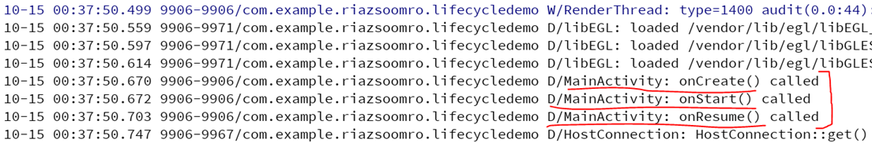
Activity Lifecycle - Example
When we first launch the application, our first batch of lifecycle methods is invoked, in the expected order:

Slide 32
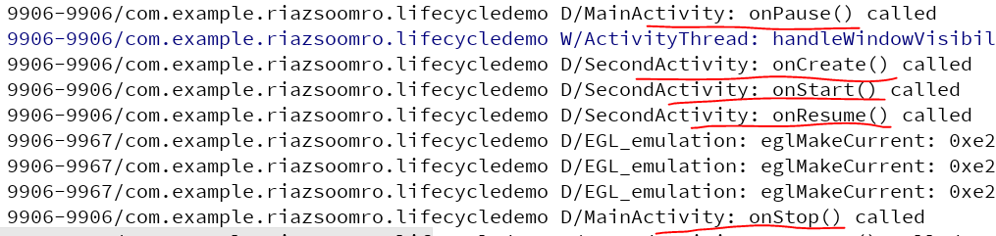
Activity Lifecycle - Example
If we click the button on the first activity to start up the second, we get:
Notice that our first activity is paused before the second activity starts up.

Slide 33
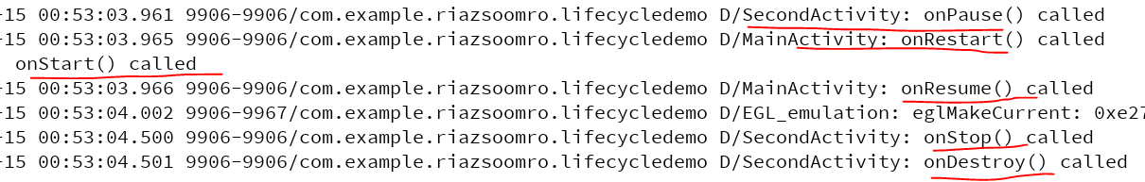
Activity Lifecycle - Example
If we press the BACK button on the second activity, returning to the first activity, we see:
Notice how, once again, going onto the screen happens in between onPause() and onStop() of the activity leaving the screen. Also notice that onDestroy() is called immediately after onStop(), because the activity was finished via the BACK button.

Slide 34
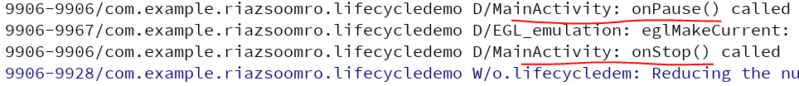
Activity Lifecycle - Example
If we now press the HOME button, to bring the home screen activity to the foreground, we see:
There is no onDestroy(), because the application is still running and nothing finished the activity. Eventually, the device may terminate our process, and if that happens, we would see the onDestroy() Logcat message.

Slide 35
Thank you!
Any Questions???

